Slide 1
Microprocessor?
A microprocessor is central processing unit of a microcomputer,
It has ability to perform arithmetical and logical operations.
It is a single chip which is able to process data.
It can control all components connected to computer like memory and I/O devices etc.
It executes sequence of instructions in steps of fetching, decoding, execution and write operations.
It has array of register to store instructions.
3

Slide 2
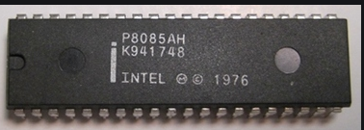
Introduction To Microprocessor
Microprocessors are integrated electrical circuits that are capable of carrying out the instructions of a computer software application or program.
A device that uses a microprocessor is normally capable of many functions, such as word processing, calculation, and communication via Internet or telephone.
Fig.1
https://www.daenotes.com/electronics/digital-electronics/Intel-8085-8-bit-microprocessor

Slide 3
CONTD…
The central processing unit (CPU) is a chip that functions as the brains of the computer.
It is made of transistors--millions of transistors, in fact.
Microprocessors are the circuitry that surround the CPU. The microprocessor is more than the CPU. It contains other processors, for example, the graphics processor unit. Sound cards and network cards are encased in microprocessors. So a CPU is part of a microprocessor, but a microprocessor is more than the CPU.

Slide 4
Contd..
μp is a programmable integrated device that has computing and decision making capability, similar to CPU of a computer.
Can be:
1) embedded in a larger system
2) a stand alone unit controlling processor
μp communicates and operates in the binary number 0 & 1, called bits.
Each μp has a fixed set of instructions in the form of binary patterns called machine language.

Slide 5
Basic Concepts
Differences between:
Microcomputer – a computer with a microprocessor as its CPU. Includes memory, I/O etc.
Microprocessor – silicon chip which includes ALU, register circuits & control circuits
Microcontroller – silicon chip which includes microprocessor, memory & I/O in a single package.

Slide 6
What is a Microprocessor?
The word comes from the combination micro and processor.
Processor means a device that processes whatever comes as an input. In this context processor means a device that processes numbers, specifically binary numbers, 0’s and 1’s.
To process means to manipulate. It is a general term that describes all manipulation. Again in this content, it means to perform certain operations on the numbers that depend on the microprocessor’s design.

Slide 7
What about micro?
Micro is a new addition.
In the late 1960’s, processors were built using discrete elements.
These devices performed the required operation, but were too large and too slow.
In the early 1970’s the microchip was invented. All of the components that made up the processor were now placed on a single piece of silicon. The size became several thousand times smaller and the speed became several hundred times faster. The “Micro”Processor was born.

Slide 8
Basic Concepts
The μp applications are classified primarily in two categories:
Reprogrammable system (PC)
Embedded system (washing machine)
In embedded system, μp is a part of a final product and is not available for reprogramming to the end user.

Slide 9
Definition of the Microprocessor
A μp is a multipurpose, programmable, clock-driven, register based electronic device that reads binary instructions from a storage device called memory, accepts binary data as input and process data according to those instructions and provides results as output.

Slide 10
Definition (Contd.)
Lets expand each of the underlined words:
Programmable device: The microprocessor can perform different sets of operations on the data it receives depending on the sequence of instructions supplied in the given program.
By changing the program, the microprocessor manipulates
the data in different ways.
Instructions: Each microprocessor is designed to execute a specific group of operations. This group of operations is called an instruction set. This instruction set defines what the microprocessor can and cannot do.

Slide 11
Definition (Contd.)
accepts binary data : The data that the microprocessor manipulates must come from somewhere.
It comes from what is called “input devices”.
These are devices that bring data into the system from the outside world.
These represent devices such as a keyboard, a mouse, switches, etc.

Slide 12
Definition (Contd.)
– Binary Data(Numbers): The microprocessor has a very narrow view on life. It only understands binary numbers.
A binary digit is called a bit (which comes from binary digit).
The microprocessor recognizes and processes a group of bits together. This group of bits is called a “word”.
The number of bits in a Microprocessor’s word, is a measure of its “abilities”.

Slide 13
Definition (Contd.)
Words, Bytes, etc.
The earliest microprocessor (the Intel 8088 and Motorola’s 6800) recognized 8-bit words.
They processed information 8-bits at a time. That’s why they are called “8-bit processors”. They can handle large numbers, but in order to process these numbers, they broke them into 8-bit pieces and processed each group of 8-bits separately.
Later microprocessors (8086 and 68000) were designed with 16-bit words.
A group of 8-bits were referred to as a “half-word” or “byte”.
A group of 4 bits is called a “nibble”.
Also, 32 bit groups were given the name “long word”.
Today, all processors manipulate at least 32 bits at a time and there exists microprocessors that can process 64, 80, 128 bits

Slide 14
Definition (Contd.)
process data (Arithmetic and Logic Operations):
Every microprocessor has arithmetic operations such as add and subtract as part of its instruction set.
Most microprocessors will have operations such as multiply and divide.
Some of the newer ones will have complex operations such as square root.
In addition, microprocessors have logic operations as well. Such as AND, OR, XOR, shift left, shift right, etc.
Again, the number and types of operations define the microprocessor’s instruction set and depends on the specific microprocessor.

Slide 15
Definition (Contd.)
storage device called memory :
First, what is memory?
Memory is the location where information is kept while not in current use.
Memory is a collection of storage devices. Also, in many cases, these storage devices are grouped into groups of 8. These 8 storage locations can only be accessed together. So, one can only read or write in terms of bytes to and form memory.
Memory is usually measured by the number of bytes it can hold.
It is measured in Kilos, Megas and lately Gigas. A Kilo in computer language is 2¹⁰ =1024. So, a KB (KiloByte) is 1024 bytes. Mega is 1024 Kilos and Giga is 1024 Mega.

Slide 16
Definition (Contd.)
Stored in memory:
When a program is entered into a computer, it is stored in memory. Then as the microprocessor starts to execute the instructions, it brings the instructions from memory one at a time.
Memory is also used to hold the data.
– The microprocessor reads (brings in) the data from memory when it needs it and writes (stores) the results into memory when it is done.

Slide 17
Definition (Contd.)
provides results : For the user to see the result of the execution of the program, the results must be presented in a human readable form.
The results must be presented on an output device.
This can be the monitor, a paper from the printer, a simple LED or many other forms.

Slide 18
A Microprocessor-based system
From the above description, we can draw the following block diagram to represent a microprocessor-based system:
Input
Output
Memory

Slide 19
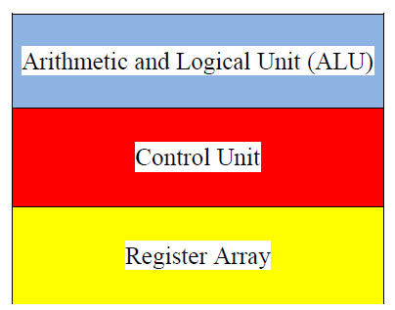
Inside The Microprocessor
Internally, the microprocessor is made up of 3 main units.
The Arithmetic/Logic Unit (ALU)
The Control Unit.
An array of registers for holding data while it is being manipulated.

Slide 20
Organization of a microprocessor-based system
Let’s expand the picture a bit.
I/O Input / Output
ALU | Register Array
Control
System Bus
Memory
ROM RAM

Slide 21
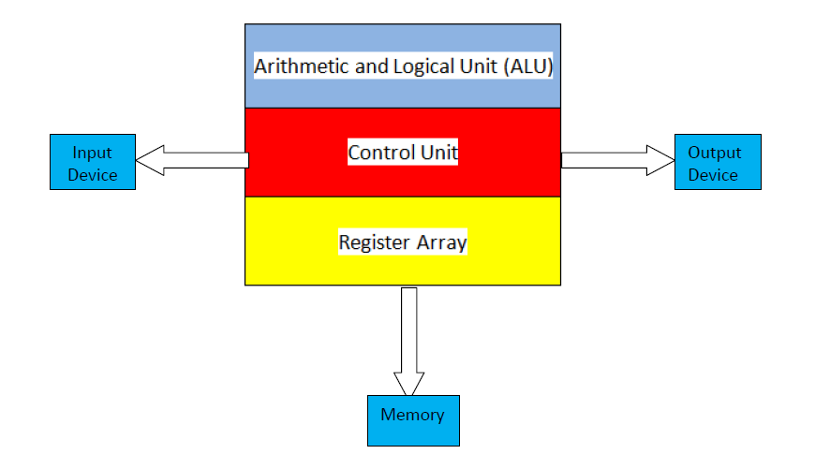
Microcomputer?
When a microprocessor, as central processing unit, combined with memory like RAM and ROM, and input/output circuitry, it becomes microcomputer
5

Slide 22
Basic components of a microprocessor
Arithmetic. and Logic Unit
Registers
Control Unit
Cache Memory
6

Slide 23
System Bus
Address Bus
Address bus carries address of memory.
Data Bus
A data bus used to transfer data from one module to another module.
Control bus
It comprised of various single lines that carry control signals.

Slide 24
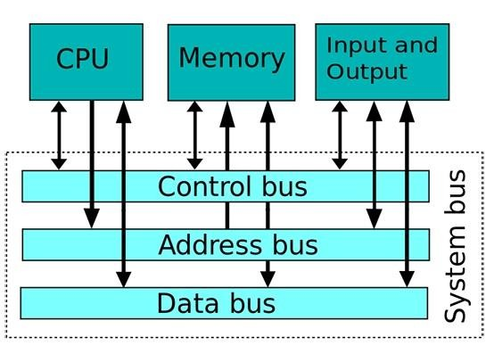
System Bus

Slide 25
Memory
Memory stores information such as instructions and data in binary format (0 and 1). It provides this information to the microprocessor whenever it is needed.
Usually, there is a memory “sub-system” in a microprocessor-based system. This sub-system includes:
The registers inside the microprocessor
Read Only Memory (ROM)
used to store information that does not change.
Random Access Memory (RAM) (also known as Read/Write Memory).
used to store information supplied by the user. Such as programs and data.

Slide 26
Memory Map and Addresses
The memory map is a picture representation of the address range and shows where the different memory chips are located within the address range.
₀₀₀₀ 0000
EPROM
RAM 1
RAM 2
RAM 3
RAM 4
Address Range of EPROM Chip
3FFF
4400
Address Range of 1st RAM Chip
5FFF
6000
Address Range of 2nd RAM Chip
Address Range
8FFF
9000
A3FF A400
Address Range of 3rd RAM Chip
Address Range of 4th RAM Chip
F7FF
FFFF

Slide 27
Memory
To execute a program:
the user enters its instructions in binary format into the memory.
The microprocessor then reads these instructions and whatever data is needed from memory, executes the instructions and places the results either in memory or produces it on an output device.

Slide 28
The three cycle instruction execution model
To execute a program, the microprocessor “reads” each instruction from memory, “interprets” it, then “executes” it.
To use the right names for the cycles:
The microprocessor fetches each instruction,
decodes it,
Then executes it.
This sequence is continued until all instructions are performed.

Slide 29
Machine Language
The number of bits that form the “word” of a microprocessor is fixed for that particular processor.
These bits define a maximum number of combinations.
For example an 8-bit microprocessor can have at most 2⁸ = 256 different combinations.
However, in most microprocessors, not all of these combinations are used.
Certain patterns are chosen and assigned specific meanings.
Each of these patterns forms an instruction for the microprocessor.
The complete set of patterns makes up the microprocessor’s machine language.

Slide 30
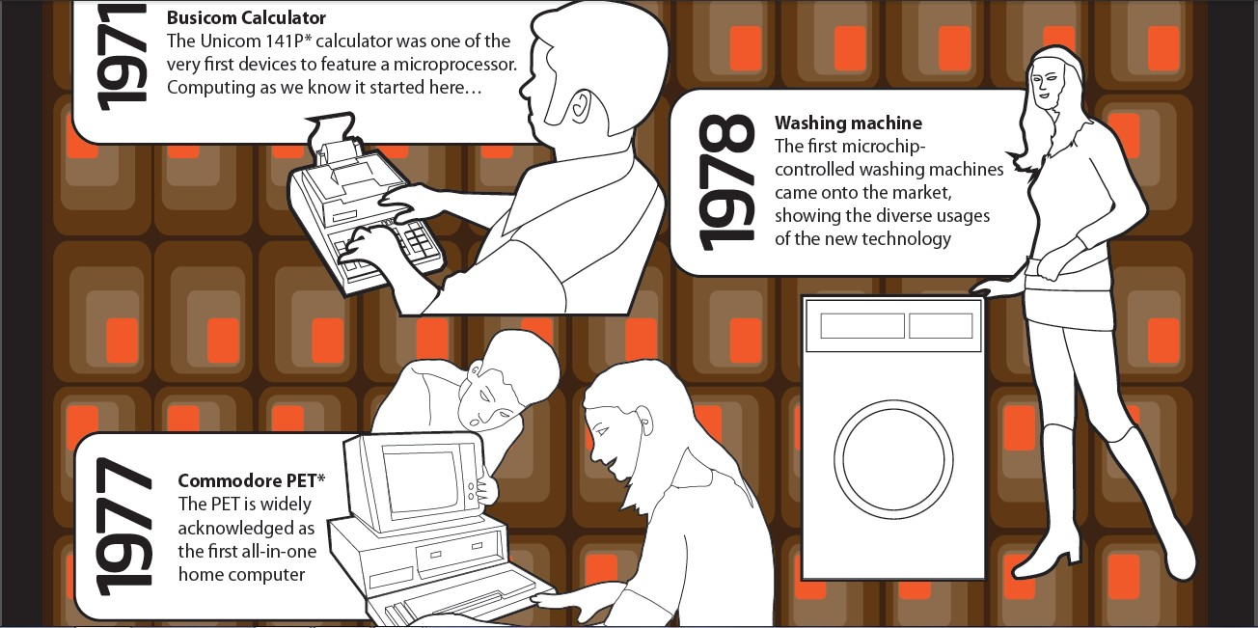
Evolution of Microprocessor

Slide 31

Evolution of Microprocessor

Slide 32
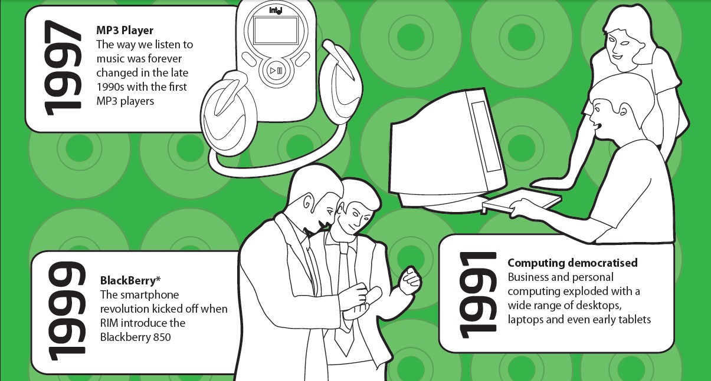
Evolution of Microprocessor

Slide 33
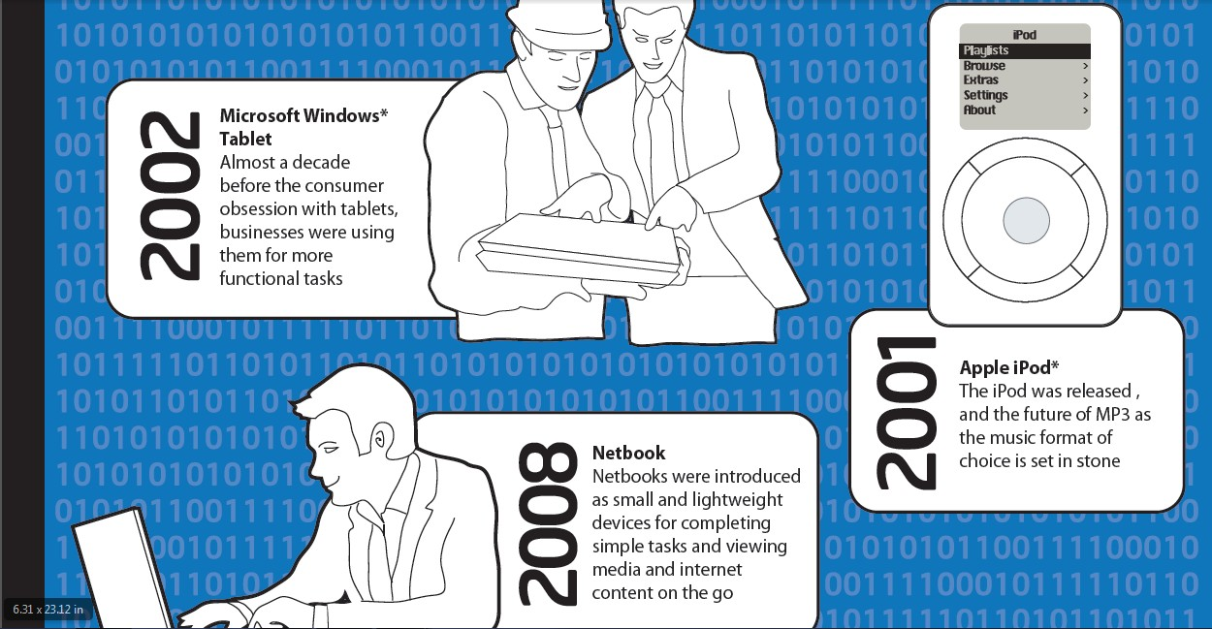
Evolution of Microprocessor

Slide 34

Evolution of Microprocessor

Slide 35
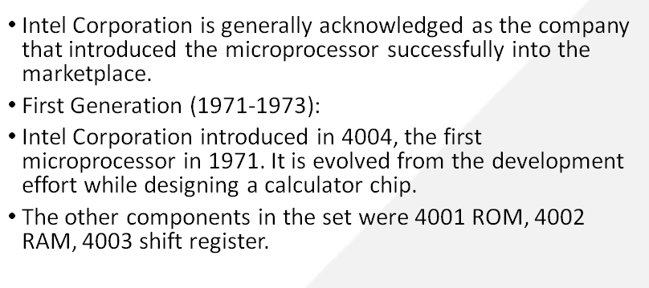
Evolution of Microprocessor

Slide 36
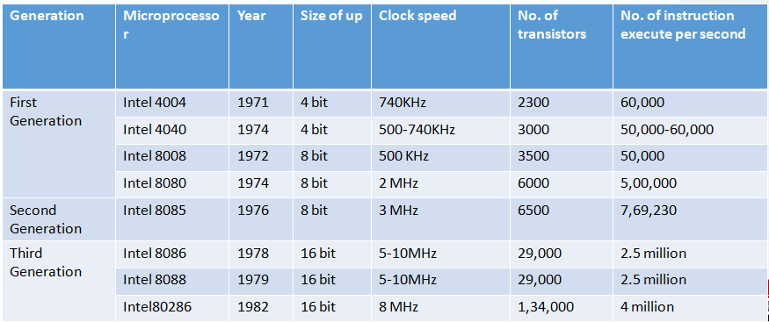
Evolution of Microprocessor

Slide 37
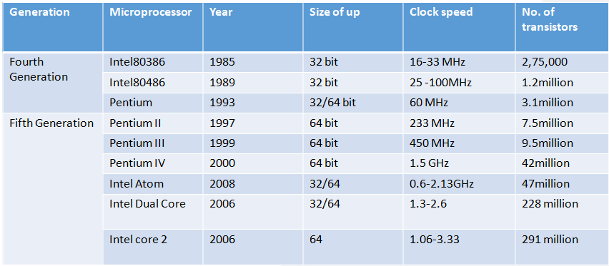
Evolution of Microprocessor

Slide 38
Evolution of Microprocessor
Generation | Microprocessor | Year | Clock speed
Fifth Generation | Intel core i3 | 2008 | 1.2-3.7 GHz
 | Intel core i5 | 2009 | 1.06-3.6 GHz
 | Intel core i7 | 2010 | 1.6-4.4 GHz

Slide 39

Architecture
Two Types of Architecture
Von Neumann Architecture
Harvard Architecture
Von Neumann
First proposed by John von Neumann
Only one data path for both instructions and data
Hence CPU does one operation at a time
Simpler hardware design, Flexible program and Data storage
Apex Institute of Technology- CSE

Slide 40
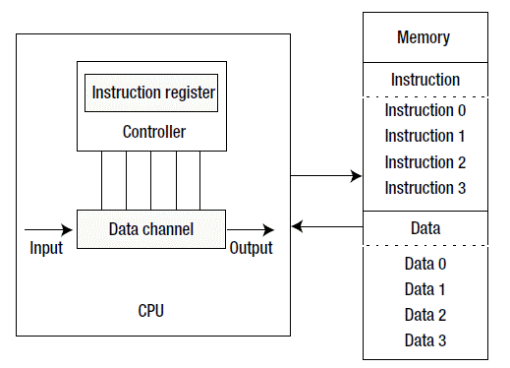
Von Neumann Architecture
Apex Institute of Technology- CSE

Slide 41
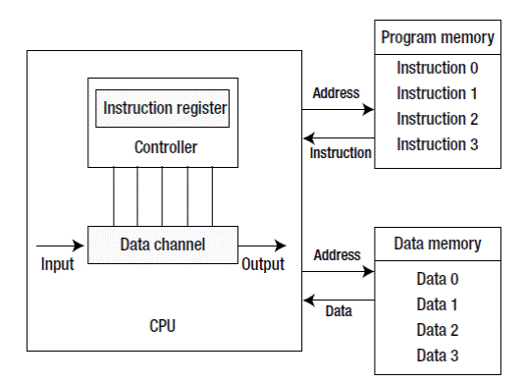
Harvard Architecture
Compared with the Von Neumann architecture, a Harvard architecture processor has two outstanding features.
First, instructions and data are stored in two separate memory modules; instructions and data do not coexist in the same module.
Second, two independent buses are used as dedicated communication paths between the CPU and memory; there is no connection between the two buses
Because of greater memory
bandwidth, it becomes greater
choice for data signal processing
Apex Institute of Technology- CSE

Slide 42
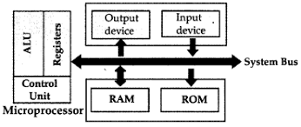
Microprocessor
Multipurpose, Programmable device
Accepts data as input
Processes data as per instructions stored in memory
Produces output
Apex Institute of Technology- CSE

Slide 43
Microprocessor
Three basic characteristics:
Instruction Set:
A command given to a digital machine to perform an operation on a piece of data is called an instruction
The possible operations a microprocessor can execute, is determined through its instruction set
Word Size:
The numbers of bits processed in single instruction is called its word size. 32-bit processor means it has a word size of 32 bits.
Word size determines the amount of RAM that can be accessed at one go and total number of pins on the microprocessor
Clock Speed:
The speed at which the microprocessor executes instructions is called clock speed
Clock speeds are measured in MHz or GHz where 1 MHz means 1 million cycles per second whereas 1 GHz equals to 1 billion cycles per second
Apex Institute of Technology- CSE

Slide 44
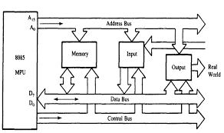
Microprocessor
Three Buses:
- Address Bus: Unidirectional, responsible for carrying address of a memory location or I/O port from CPU to memory or I/O port.
- Data Bus: Lines that carry data to and from memory are called data bus.
It is a bidirectional bus with width equal to word length of the microprocessor.
- Control Bus: Lines that carry control signals like clock signals, interrupt signal or ready signal are called control bus.
Apex Institute of Technology- CSE

Slide 45
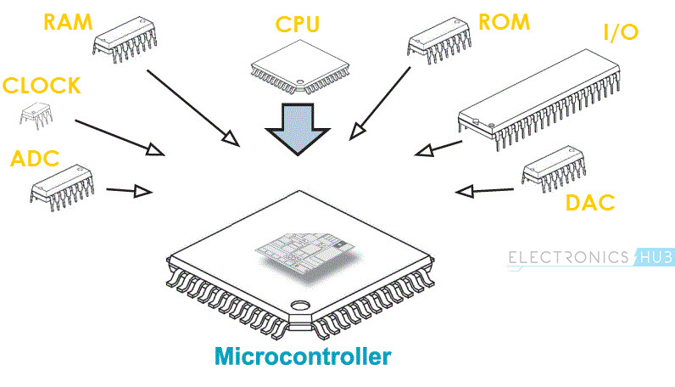
Microcontroller
A Microcontroller is a VLSI Integrated Circuit (IC) that contains electronic computing unit and logic unit, Memory I/O Ports (Input / Output Ports) and few other components integrated on a single chip.
Also called as a Computer-on-a-Chip or a Single-Chip-Computer
Apex Institute of Technology- CSE

Slide 46
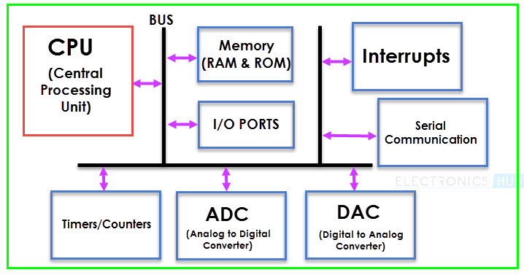
Embedded System Microcontroller
Apex Institute of Technology- CSE

Slide 47
Embedded System Microcontroller
CPU
Central Processing Unit or CPU is the brain of the Microcontroller. It consists of an Arithmetic Logic Unit (ALU) and a Control Unit (CU). A CPU reads, decodes and executes instructions to perform Arithmetic, Logic and Data Transfer operations.
Memory
The various memories installed inside the microcontroller are RAM and ROM (EEPROM, EPROM, etc) or flash memories for storing program source codes.
I/O Ports
The interface for the Microcontroller to the external world is provided by the I/O Ports or Input/Output Ports. Inputs device like Switches, Keypads, etc. provide information from the user to the CPU in the form of Binary Data. The CPU, upon receiving the data from the input devices, executes appropriate instructions and gives response through Output Devices like LEDs, Displays, Printers, etc.
Apex Institute of Technology- CSE

Slide 48
Embedded System Microcontroller
Timers and Counters
Mainly they are used for the purpose of lock functions, modulations, pulse generations, frequency measuring and making oscillations so that the task can be performed with the stipulated time interval.
Bus
A System bus is a group of connecting wire that connect the CPU with other peripherals like Memory, I/O Ports and other supporting components
Serial Port
One of the important requirement of a Microcontroller is to communicate with other device and peripherals (external). Serial Port proves such interface through serial communication. Most common serial communication implemented in Microcontrollers is UART.
Apex Institute of Technology- CSE

Slide 49
Embedded System Microcontroller
Interrupts
A very important feature of a Microcontroller is Interrupts and its Interrupt Handling Mechanism. Interrupts can be external, internal, hardware related or software related.
ADC (Analog to Digital Converter)
The ADC Circuit forms the interface between the external Analog Input devices and the CPU of the Microcontroller. Almost all sensors are analog devices and the analog data from these sensors must be converted in to digital data for the CPU to understand.
DAC (Digital to Analog Converter)
Digital to Analog Converter or DAC is a circuit, that works in contrast to an ADC i.e. it converts Digital Signals to Analog Signals. DAC forms the bridge between the CPU of the Microcontroller and the external analog devices.
Apex Institute of Technology- CSE

Slide 50
Computer Organization RISC Vs CISC
CISC (Complex Instruction Set Computers)
Richer instruction set, some simple, some very complex
Instructions are of variable length
Instructions take more than one clock cycle usually
Work well with simpler compilers
Examples: Intel 386 & 486, Pentium, Pentium II and III, Motorola 68000, etc.
Apex Institute of Technology- CSE

Slide 51
Embedded System RISC Vs CISC
RISC (Reduced Instruction Set Computers)
Simple primitive instructions and addressing modes
Usually Instructions execute in one clock cycle
Uniformed length instructions
Complexity pushed to the compiler
Supports fewer instructions
For example, Pentium1, AMD K6, Intel P6, ARM etc
Apex Institute of Technology- CSE

Slide 52
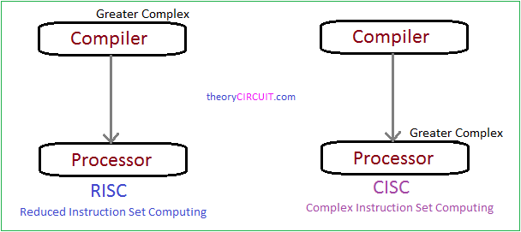
Embedded System RISC Vs CISC
Apex Institute of Technology- CSE

Slide 53
Architecture of microprocessor 8086
Course Outcome
This will be covered in this
lecture
CO Number | Title | Level
CO1 | Students will be able to differentiate between families of processors based on architectural requirements. | Understand
CO2 | Students will be able to compare the features of the processors based on the design requirements of the system. | Understand
CO3 | Students will be able to understand different communication protocols for hardware interfacing. | Understand
2

Slide 54
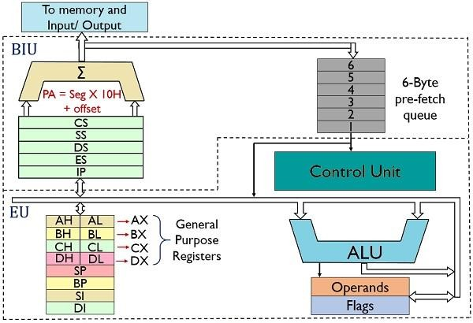
8086 Architecture

Slide 55
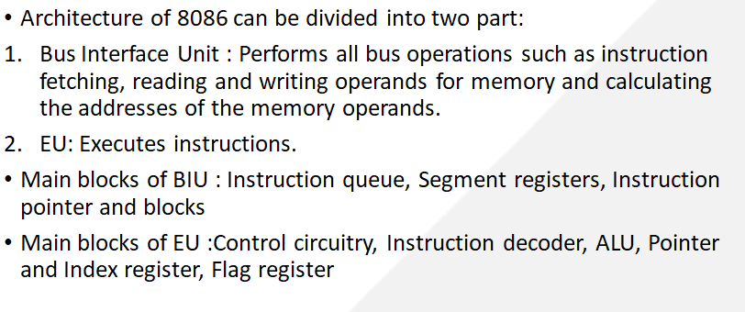
8086 Architecture

Slide 56
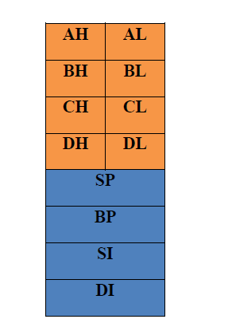
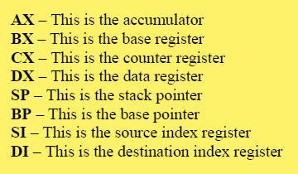
8086 Registers
General Purpose Registers

Slide 57
Physical Memory Organization in 8086
Physical Memory
Code segment (64KB)
Data segment (64KB)
Extra segment (64KB)
Stack segment (64KB)
00000
Since 8086 has 20 address lines. It can access 2^20=1 MB
Memory address in 1 MB ranges from 00000H to FFFFFH
Memory is constructed using RAM, ROM and EPROM chips
1 MB
FFFFF

Slide 58
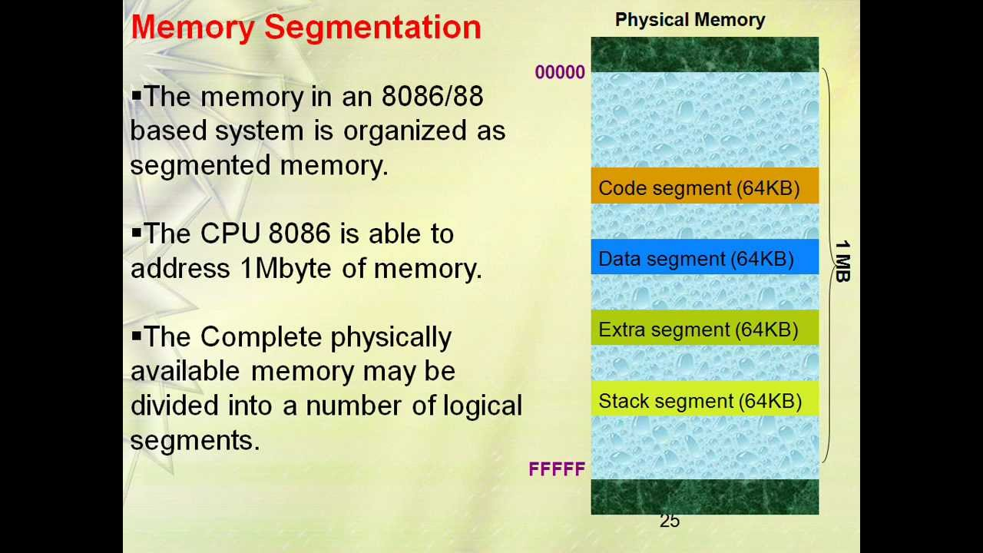
MEMORY
00000
BIU
Segment Registers
34BA0
CODE (64k)
44B9F
CSR
34BA
44EB
54EB
695E
44EB0
DATA (64K)
54EAF
1 MB
DSR
54EB0
ESR
EXTRA (64K)
64EAF
SSR
695E0
STACK (64K)
795DF
Figure 5:[4]

Slide 59
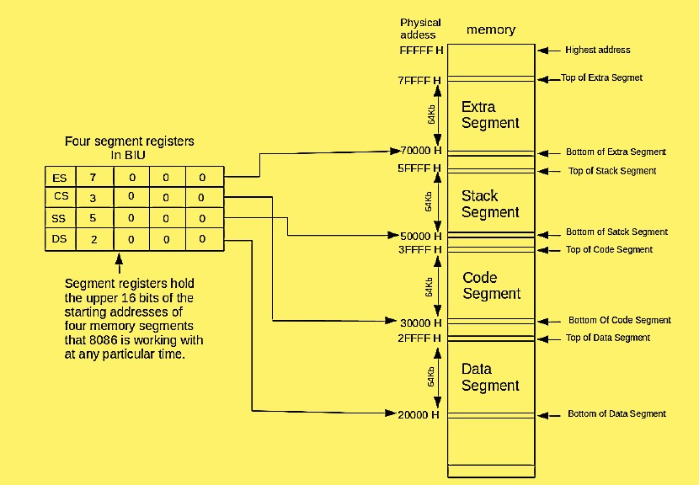
Memory Segmentation
8086 memory is divided into four segments.
Extra Segment
Stack Segment
Code Segment
Data Segment

Slide 60
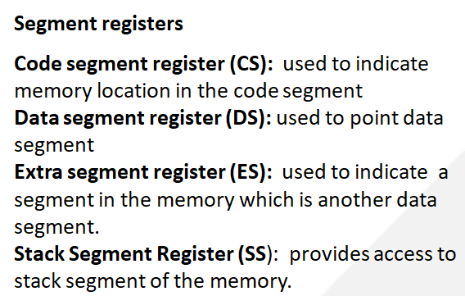
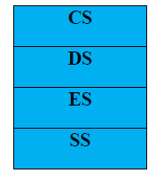
8086 Registers

Slide 61
How to find base address?
Base address of any segment can be obtained by adding four binary 0’s to the right portion of the content of corresponding segment register
It is like shifting the content of the segment registers to the right by 4 bits.
E.g: If the value of CS is 2000H , base address of CS is obtained by adding 4 binary digits or 1 Hexadecimal zero to the content of CS : 20000H
Formula : BA*10H

Slide 62
CS
34BA
IP
8AB4
Code segment
The following examples shows the CS:IP scheme of address formation:
Inserting a hexadecimal 0H (0000B)
with the CSR or shifting the CSR
four binary digits left
34BA0
8AB4 (offset)
3D645
3 4 B A 0 ( C S ) +
8 A B 4 ( I P )
3 D 6 5 4 (next address)
44B9F

Slide 63
Example For Address Calculation (segment: offset)
If the data segment starts at location 1000h and a data reference contains the address 29h where is the actual data?
Offset
0000 0000 0010 1001
Segment Address
0001 0000 0000 0000
0000
Required Address
0001 0000 0000 0010 1001

Slide 64
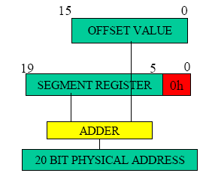

Slide 65
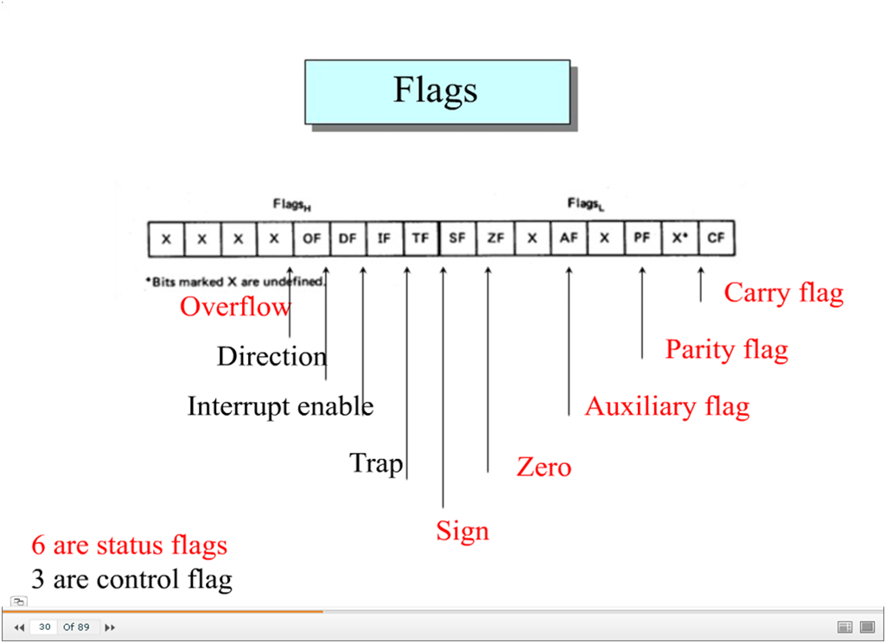
8086 Flag Register

Slide 66
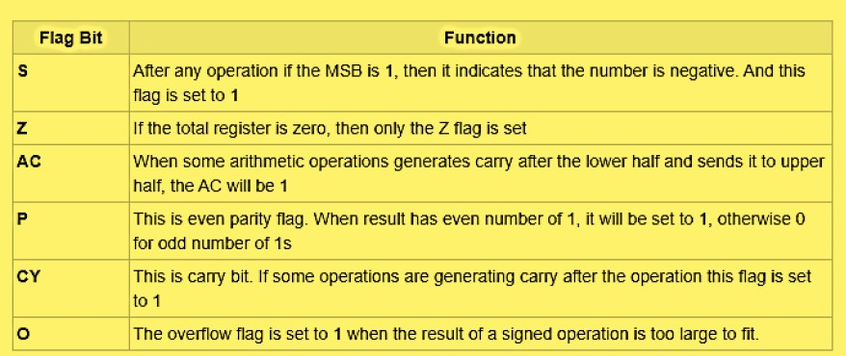
8086 Flag Registers
Status Flags

Slide 67
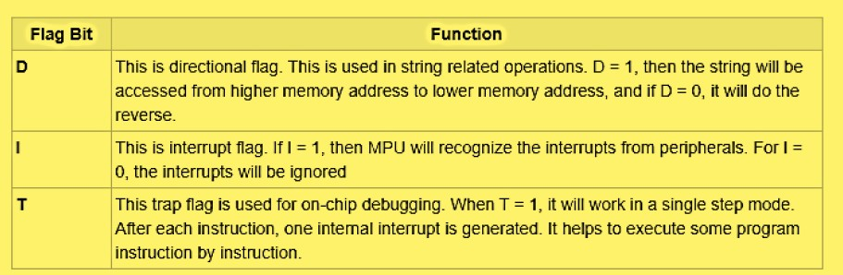
8086 Flag Registers
Control Flags

Slide 68
Pin description of microprocessor 8086
Course Outcome
This will be covered in this
lecture
CO Number | Title | Level
CO1 | Students will be able to differentiate between families of processors based on architectural requirements. | Understand
CO2 | Students will be able to compare the features of the processors based on the design requirements of the system. | Understand
CO3 | Students will be able to understand different communication protocols for hardware interfacing. | Understand
2

Slide 69
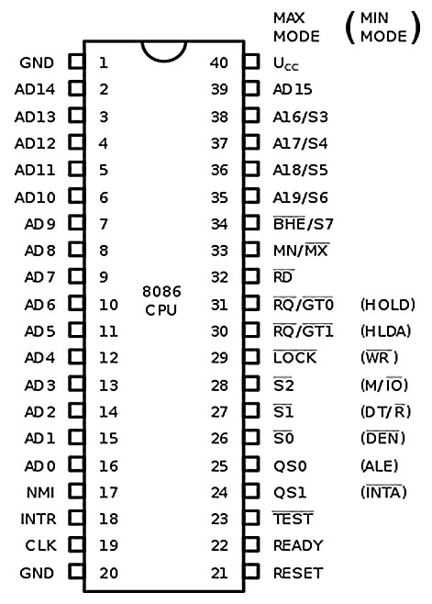
8086 Pin description

Slide 70
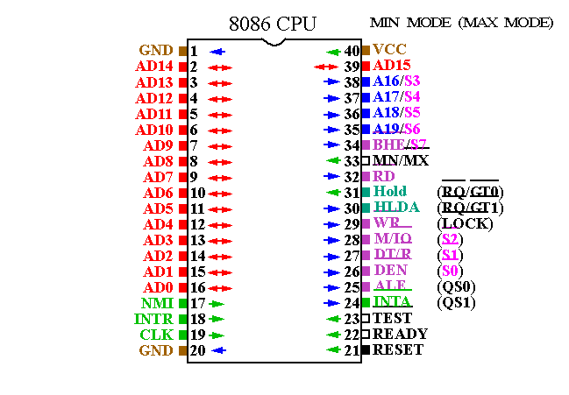
Figure 1: [1]

Slide 71
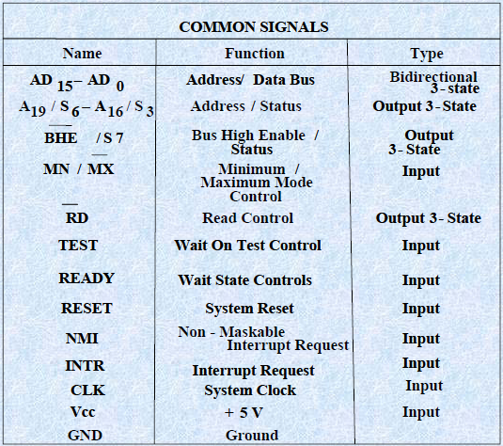
Internal Architecture of 8086 (cont..)
Figure 2:[2]

Slide 72
Various Pins of 8086
Pins common to Minimum and Maximum modes:
AD15-AD0
A19/S6
A18/S5
A17/S4
A16/S4
BHE’/S7
RD’
READY
INTR
TEST
CLK
MN/MX

Slide 73
Power supply and frequency signals
It uses 5V DC supply at VCC pin 40, and uses ground at VSS pin 1 and 20 for its operation.
Clock signal
Clock signal is provided through Pin-19. It provides timing to the processor for operations. Its frequency is different for different versions, i.e. 5MHz, 8MHz and 10MHz.
Address/data bus
AD0-AD15. These are 16 address/data bus. AD0-AD7 carries low order byte data and AD8AD15 carries higher order byte data. During the first clock cycle, it carries 16-bit address and after that it carries 16-bit data.

Slide 74
Address/status bus
A16-A19/S3-S6. These are the 4 address/status buses. During the first clock cycle, it carries 4-bit address and later it carries status signals.
S7/BHE’
BHE’ stands for Bus High Enable. It is available at pin 34 and used to indicate the transfer of data using data bus D8-D15. This signal is low during the first clock cycle, thereafter it is active.
Read(RD’)
It is available at pin 32 and is used to read signal for Read operation.

Slide 75
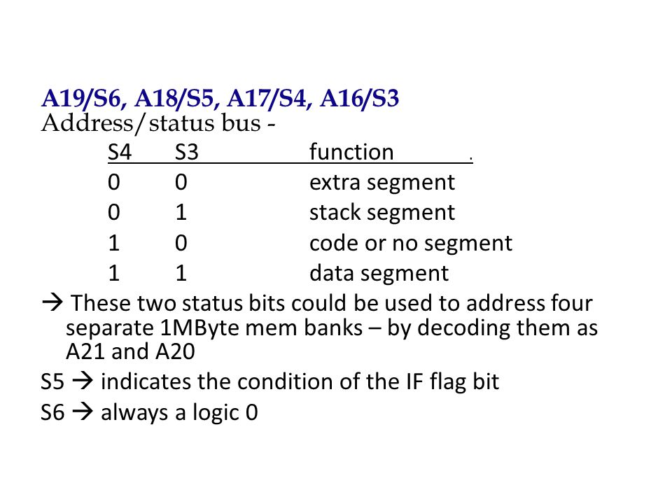

Slide 76
Ready
It is available at pin 22. It is an acknowledgement signal from I/O devices that data is transferred. It is an active high signal. When it is high, it indicates that the device is ready to transfer data. When it is low, it indicates wait state.
INTR
It is available at pin 18. It is an interrupt request signal, which is sampled during the last clock cycle of each instruction to determine if the processor considered this as an interrupt or not.
NMI
It stands for non-maskable interrupt and is available at pin 17. It is an edge triggered input, which causes an interrupt request to the microprocessor.

Slide 77
TEST
This signal is like wait state and is available at pin 23. When this signal is high, then the processor has to wait for IDLE state, else the execution continues.
MN/MX’
It stands for Minimum/Maximum and is available at pin 33. It indicates what mode the processor is to operate in; when it is high, it works in the minimum mode and vice-versa.
INTA’
It is an interrupt acknowledgement signal and available at pin 24. When the microprocessor receives this signal, it acknowledges the interrupt.

Slide 78
TWO OPERATING MODES OF 8086
•The minimum mode is selected by applying logic 1 to the MN / MX input pin. This is a single microprocessor configuration.
•The maximum mode is selected by applying logic 0 to the MN / MX input pin. This is a multi micro processors configuration.

Slide 79
Operating Modes of 8086
Course Outcome
This will be covered in this
lecture
CO Number | Title | Level
CO1 | Students will be able to differentiate between families of processors based on architectural requirements. | Understand
CO2 | Students will be able to compare the features of the processors based on the design requirements of the system. | Understand
CO3 | Students will be able to understand different communication protocols for hardware interfacing. | Understand
2

Slide 80
Minimum & Maximum Mode Interface
8086 Works in 2 modes
Minimum : All control signals for memory and I/O are generated by 8086. It is a uniprocessor configuration.
Maximum : Some control signals are generated externally which requires the addition of external bus controller such as 8288 to 8086. It is a multiprocessor configuration.

Slide 81
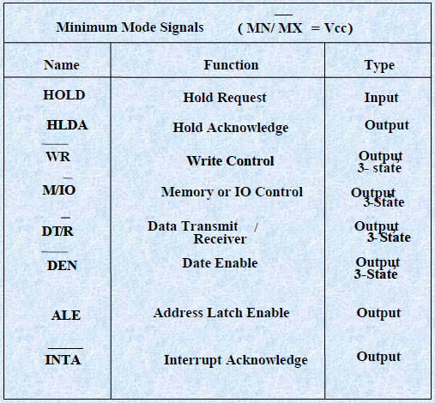
Internal Architecture of 8086 (cont..)
Figure 3:[3]

Slide 82
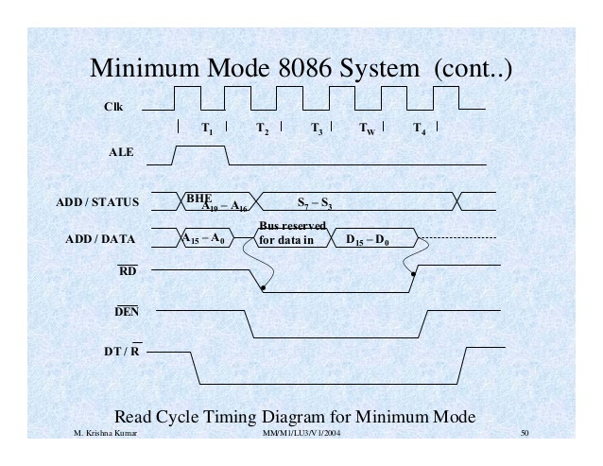
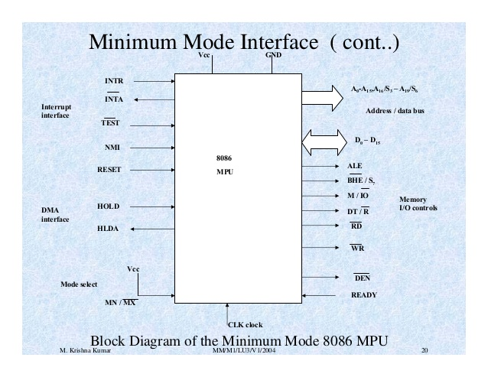
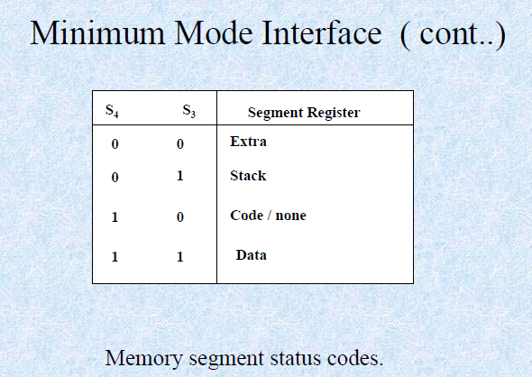
Figure 5:[5]

Slide 83
ALE
It stands for address enable latch and is available at pin 25. A positive pulse is generated each time the processor begins any operation. This signal indicates the availability of a valid address on the address/data lines.
DEN’
It stands for Data Enable and is available at pin 26. It is used to enable Transceiver 8286. The transceiver is a device used to separate data from the address/data bus.
DT/R’
It stands for Data Transmit/Receive signal and is available at pin 27. It decides the direction of data flow through the transceiver. When it is high, data is transmitted out and vice-a-versa.

Slide 84
M/IO’
This signal is used to distinguish between memory and I/O operations. When it is high, it indicates MEMORY operation and when it is low indicates the I/O operation. It is available at pin 28.
WR’
It stands for write signal and is available at pin 29. It is used to write the data into the memory or the output device depending on the status of M/IO signal.
HLDA
It stands for Hold Acknowledgement signal and is available at pin 30. This signal acknowledges the HOLD signal.
HOLD
This signal indicates to the processor that external devices are requesting to access the address/data buses. It is available at pin 31.

Slide 85
QS1 and QS0
These are queue status signals and are available at pin 24 and 25. These signals provide the status of instruction queue. Their conditions are shown in the following table −
QS0 | QS1 | Status
0 | 0 | No operation
0 | 1 | First byte of opcode from the queue
1 | 0 | Empty the queue
1 | 1 | Subsequent byte from the queue

Slide 86
S0, S1, S2
These are the status signals that provide the status of operation, which is used by the Bus Controller 8288 to generate memory & I/O control signals. These are available at pin 26, 27, and 28. Following is the table showing their status
S2 S1 S0 CHARACTERISTICS
0 0 0 Interrupt acknowledge
0 0 1 Read I/O port
0 1 0 Write I/O port
0 1 1 Halt
1 0 0 Code access
1 0 1 Read memory
1 1 0 Write memory
1 1 1 Passive state

Slide 87
LOCK’
When this signal is active, it indicates to the other processors not to ask the CPU to leave the system bus. It is activated using the LOCK prefix on any instruction and is available at pin 29.
RQ’/GT1’ and RQ’/GT0’
These are the Request/Grant signals used by the other processors requesting the CPU to release the system bus. When the signal is received by CPU, then it sends acknowledgment. RQ/GT0 has a higher priority than RQ/GT1.

Slide 88
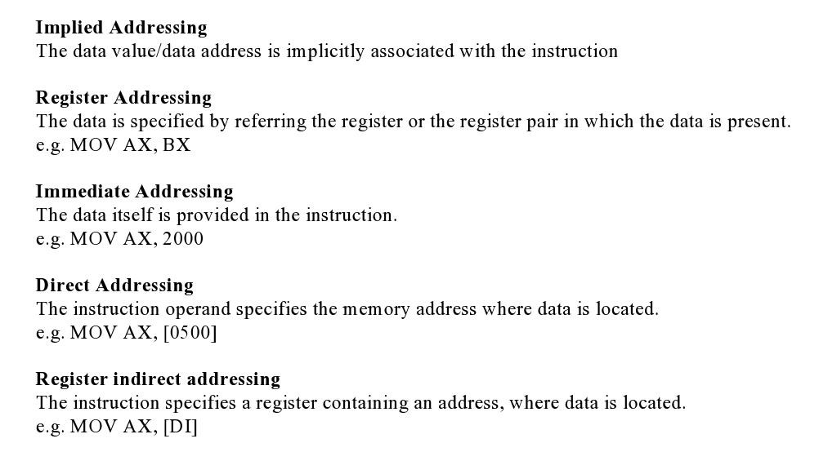
Addressing Modes

Slide 89
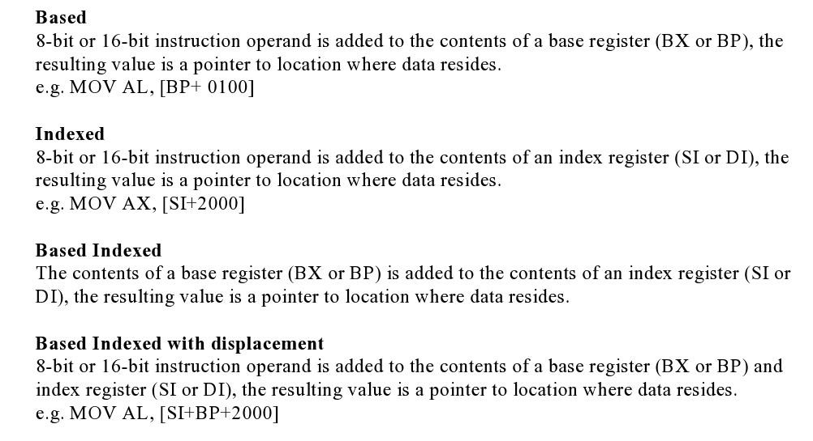
Addressing Modes

Slide 90
Operating Modes of 8086
Course Outcome
This will be covered in this
lecture
CO Number | Title | Level
CO1 | Students will be able to differentiate between families of processors based on architectural requirements. | Understand
CO2 | Students will be able to compare the features of the processors based on the design requirements of the system. | Understand
CO3 | Students will be able to understand different communication protocols for hardware interfacing. | Understand
2

Slide 91
Instruction Set of 8086
An instruction is a binary pattern designed inside a microprocessor to perform a specific function.
The entire group of instructions that a microprocessor supports is called Instruction Set.
8086 has more than 20,000 instructions.
‹#›
ohmshankar.ece@act.edu.in
21-Nov-2010

Slide 92
Classification of Instruction Set
1. Arithmetic Instructions and Logical Instruction
2. Data Transfer Instructions
3. Branch and Loop Instruction
4. M/C control Instruction
5. Flag Manipulation Instructions
6. Shift and Rotate Instruction
7. String Instructions
‹#›

Slide 93
1. Arithmetic And Logical Instructions

Slide 94
Arithmetic Instructions
ADD Des, Src:
It adds a byte to byte or a word to word.
It effects AF, CF, OF, PF, SF, ZF flags.
E.g.:
ADD AL, 74H
ADD DX, AX
ADD AX, [BX]
‹#›

Slide 95
Arithmetic Instructions
ADC Des, Src:
It adds the two operands with CF.
It effects AF, CF, OF, PF, SF, ZF flags.
E.g.:
ADC AL, 74H
ADC DX, AX
ADC AX, [BX]
‹#›

Slide 96
Arithmetic Instructions
SUB Des, Src:
It subtracts a byte from byte or a word from word.
It effects AF, CF, OF, PF, SF, ZF flags.
For subtraction, CF acts as borrow flag.
E.g.:
SUB AL, 74H
SUB DX, AX
SUB AX, [BX]
‹#›

Slide 97
Arithmetic Instructions
SBB Des, Src:
It subtracts the two operands and also the borrow from the result.
It effects AF, CF, OF, PF, SF, ZF flags.
E.g.:
SBB AL, 74H
SBB DX, AX
SBB AX, [BX]
‹#›

Slide 98
Arithmetic Instructions
MUL Src:
It is an unsigned multiplication instruction.
It multiplies two bytes to produce a word or two words to produce a double word.
AX = AL * Src
DX : AX = AX * Src
This instruction assumes one of the operand in AL or AX.
Src can be a register or memory location. And Flags-OF, CF
Unused bits of destination register is always filled with sign bit
IMUL Src:
It is a signed multiplication instruction.
‹#›

Slide 99
Arithmetic Instructions
DIV Src:
It is an unsigned division instruction.
It divides word by byte or double word by word.
The operand is stored in AX, divisor is Src and the result is stored as:
AH = remainder, AL = quotient (for word/byte)
DX=remainder, AX=quotient (for D-word/word)
IDIV Src:
It is a signed division instruction.
‹#›

Slide 100
Arithmetic Instructions
CBW (Convert Byte to Word):
This instruction converts byte in AL to word in AX.
The conversion is done by extending the sign bit of AL throughout AH.
CWD (Convert Word to Double Word):
This instruction converts word in AX to double word in DX : AX.
The conversion is done by extending the sign bit of AX throughout DX.
‹#›

Slide 101
Arithmetic Instructions
INC Src:
It increments the byte or word by one.
The operand can be a register or memory location.
E.g.: INC AX
INC [SI]
‹#›

Slide 102
Arithmetic Instructions
DEC Src:
It decrements the byte or word by one.
The operand can be a register or memory location.
E.g.: DEC AX
DEC [SI]
‹#›

Slide 103
Arithmetic Instructions
CMP Des, Src:
It compares two specified bytes or words.
The Src and Des can be a constant, register or memory location.
Both operands cannot be a memory location at the same time.
The comparison is done simply by internally subtracting the source from destination.
The value of source and destination does not change, but the flags CF, ZF, SF are modified to indicate the result.
‹#›

Slide 104
Arithmetic Instructions
NEG Src:
It creates 2’s complement of a given number.
That means, it changes the sign of a number.
‹#›

Slide 105
Arithmetic Instructions
DAA (Decimal Adjust after Addition)
It is used to make sure that the result of adding two BCD numbers is adjusted to be a correct BCD number.
It only works on AL register.
For Subtraction : DAS (Decimal Adjust after Subtraction)
‹#›

Slide 106
Arithmetic Instructions
AAA (ASCII Adjust after Addition):
This Instruction Can be used to convert the contents of the AL register to unpacked BCD result
i.e. If lower nibble of AL>9 then
1. AL=AL+6 2. AH=AH+1
3. AL=AL AND 0FH
This instruction does not have any operand.
Other ASCII Instructions:
AAS (ASCII Adjust after Subtraction)
AAM (ASCII Adjust after Multiplication)
AAD (ASCII Adjust Before Division)
‹#›

Slide 107
Logical Instructions
NOT Src:
It complements each bit of Src to produce 1’s complement of the specified operand.
The operand can be a register or memory location.
e,.g NOT AX
‹#›

Slide 108
Logical Instructions
AND Des, Src:
It performs AND operation of Des and Src.
Src can be immediate number, register or memory location.
Des can be register or memory location.
Both operands cannot be memory locations at the same time.
CF and OF become zero after the operation.
PF, SF and ZF are updated.
‹#›

Slide 109
Bit Manipulation Instructions
OR Des, Src:
It performs OR operation of Des and Src.
Src can be immediate number, register or memory location.
Des can be register or memory location.
Both operands cannot be memory locations at the same time.
CF and OF become zero after the operation.
PF, SF and ZF are updated.
‹#›

Slide 110
Bit Manipulation Instructions
XOR Des, Src:
It performs XOR operation of Des and Src.
Src can be immediate number, register or memory location.
Des can be register or memory location.
Both operands cannot be memory locations at the same time.
CF and OF become zero after the operation.
PF, SF and ZF are updated.
‹#›

Slide 111
Bit Manipulation Instructions
TEST Des, Src:
It performs AND operation of Des and Src.
Src can be immediate number, and src/Des can be register or memory location.
It is Non-Destructive And means Dest is not modified only flags are affected.
Both operands cannot be memory locations at the same time.
CF and OF become zero after the operation.
PF, SF and ZF are updated.
‹#›

Slide 112
2. Data Transfer Instructions
‹#›

Slide 113
Data Transfer Instructions
MOV Des, Src:
It is used to copy the content of Src to Des
Src operand can be register, memory location or immediate operand.
Des can be register or memory operand.
Both Src and Des cannot be memory location at the same time.
E.g.:
MOV CX, 037A H
MOV AL, BL
MOV BX, [0301 H]
‹#›

Slide 114
Data Transfer Instructions
PUSH Operand:
It pushes the operand into top of stack.
E.g.: PUSH BX
POP Des:
It pops the operand from top of stack to Des.
Des can be a general purpose register, segment register (except CS) or memory location.
E.g.: POP AX
‹#›

Slide 115
Data Transfer Instructions
XCHG Des, Src:
This instruction exchanges Src with Des.
It cannot exchange two memory locations directly.
E.g.: XCHG DX, AX
‹#›

Slide 116
Data Transfer Instructions
IN Accumulator, Port Address:
It transfers the operand from specified port to accumulator register.
E.g.: IN AX, 0028 H
OUT Port Address, Accumulator:
It transfers the operand from accumulator to specified port.
E.g.: OUT 0028 H, AX
‹#›

Slide 117
Data Transfer Instructions
LEA Register, Src:
It loads a 16-bit register with the offset address of the data specified by the Src.
E.g.: LEA BX, [DI]
This instruction loads the contents of DI (offset) into the BX register.
‹#›

Slide 118
Data Transfer Instructions
LDS Des, Src:
It loads 32-bit pointer from memory source to destination register and DS.
The word is placed in the destination register and the segment is placed in DS.
This instruction Copies the word at the lower memory address to the Des reg and the word at the higher address to the segment reg i.e. DS.
E.g.: LDS BX, [0301 H]
‹#›

Slide 119
Data Transfer Instructions
LES Des, Src:
It loads 32-bit pointer from memory source to destination register and ES.
The Word is placed in the destination register and the segment is placed in ES.
This instruction is very similar to LDS except that it initializes ES instead of DS.
E.g.: LES BX, [0301 H]
‹#›

Slide 120
Data Transfer Instructions
LAHF:
It copies the lower byte of flag register to AH.
SAHF:
It copies the contents of AH to lower byte of flag register.
PUSHF:
Pushes flag register to top of stack.
POPF:
Pops the stack top to flag register.
‹#›

Slide 121
3. Branch/Program Execution Transfer Instructions
These instructions cause change in the sequence of the execution of instruction.
This change can be a conditional or sometimes unconditional.
The conditions are represented by flags.
‹#›

Slide 122
Branch Instructions
CALL Des:
This instruction is used to call a subroutine or function or procedure.
The address of next instruction after CALL is saved onto stack.
RET:
It returns the control from procedure to calling program.
Every CALL instruction should have a RET.
‹#›

Slide 123
Branch Instructions
JMP Des:
This instruction is used for unconditional jump from one place to another.
Jxx Des (Conditional Jump):
All the conditional jumps follow some conditional statements or any instruction that affects the flag.
‹#›

Slide 124
Conditional Jump Table
Mnemonic | Meaning | Jump Condition
JA | Jump if Above | CF = 0 and ZF = 0
JAE | Jump if Above or Equal | CF = 0
JB | Jump if Below | CF = 1
JBE | Jump if Below or Equal | CF = 1 or ZF = 1
JC | Jump if Carry | CF = 1
JE | Jump if Equal | ZF = 1
JNC | Jump if Not Carry | CF = 0
JNE | Jump if Not Equal | ZF = 0
JNZ | Jump if Not Zero | ZF = 0
JPE | Jump if Parity Even | PF = 1
JPO | Jump if Parity Odd | PF = 0
JZ | Jump if Zero | ZF = 1
‹#›

Slide 125
Loop Instructions
Loop Des:
This is a looping instruction.
The number of times looping is required is placed in the CX register.
With each iteration, the contents of CX are decremented.
ZF is checked whether to loop again or not.
‹#›

Slide 126
Program Execution Transfer Instructions
INTO (Interrupt on overflow):
This instruction generates type 4 interrupt (i.e. interrupt for overflow) and causes the 8086 to do an indirect far call a procedure which is written by the user to handle the overflow condition.
IRET
To return the execution to the interrupted program
‹#›

Slide 127
4. Machine Control Instructions

Slide 128
Machine Control Instructions
HLT (Halt) :- It causes the processor to enter in to the halt state. It can be stop by INTR,NMI or RESET pin
NOP (No Opration) :- It causes the processor to enter in to the wait state for 3 Clock cycles.
WAIT :- It causes the processor to enter in to the ideal state. Can be stop by TEST, INTR OR NMI pin
LOCK :- This instruction prevents other processors to take the control of shared resources. For e.g LOCK IN AL,80H
‹#›

Slide 129
5. Flag Manipulation Instructions

Slide 130
Flag Manipulation Instructions
STC:
It sets the carry flag to 1.
CLC:
It clears the carry flag to 0.
CMC:
It complements the carry flag.
‹#›

Slide 131
Flag Manipulation Instructions
STD:
It sets the direction flag to 1.
If it is set, string bytes are accessed from higher memory address to lower memory address.
CLD:
It clears the direction flag to 0.
If it is reset, the string bytes are accessed from lower memory address to higher memory address.
‹#›

Slide 132
Flag Manipulation Instructions
STI:
It sets the Interrupt flag to 1.
CLI:
It clears the Interrupt flag to 0.
‹#›

Slide 133
6. Shift And Rotate Instructions

Slide 134
Shift And Rotate Instructions
SHL/SAL Des, Count:
It shift bits of byte or word left, by count.
It puts zero(s) in LSBs.
MSB is shifted into carry flag.
If the number of bits desired to be shifted is 1, then the immediate number 1 can be written in Count.
However, if the number of bits to be shifted is more than 1, then the count is put in CL register. And recent bit to the CF (Carry flag)
‹#›

Slide 135
Shift And Rotate Instructions
SHR/SAR Des, Count:
It shift bits of byte or word right, by count.
It puts zero(s)(for SHL) and Sign bit (for SAL) in MSBs.
LSB is shifted into carry flag.
If the number of bits desired to be shifted is 1, then the immediate number 1 can be written in Count.
However, if the number of bits to be shifted is more than 1, then the count is put in CL register. And recent bit to the CF (Carry flag)
‹#›

Slide 136
Shift And Rotate Instructions
ROL Des, Count:
It rotates bits of byte or word left, by count.
LSB is transferred to MSB and also to CF.
If the number of bits desired to be shifted is 1, then the immediate number 1 can be written in Count.
However, if the number of bits to be shifted is more than 1, then the count is put in CL register. And recent bit to the CF (Carry flag)
‹#›

Slide 137
Shift And Rotate Instructions
ROR Des, Count:
It rotates bits of byte or word right, by count.
MSB is transferred to LSB and also to CF.
If the number of bits desired to be shifted is 1, then the immediate number 1 can be written in Count.
However, if the number of bits to be shifted is more than 1, then the count is put in CL register. And recent bit to the CF (Carry flag)
‹#›

Slide 138
Shift And Rotate Instructions
RCL Des, Count:
It rotates bits of byte or word right, by count.
LSB to MSB then MSB is transferred to CF and CF to LSB.
If the number of bits desired to be shifted is 1, then the immediate number 1 can be written in Count.
However, if the number of bits to be shifted is more than 1, then the count is put in CL register. And recent bit to the CF (Carry flag)
‹#›

Slide 139
Shift And Rotate Instructions
RCR Des, Count:
It rotates bits of byte or word left, by count.
MSB to LSB then LSB is transferred to CF and CF to MSB.
If the number of bits desired to be shifted is 1, then the immediate number 1 can be written in Count.
However, if the number of bits to be shifted is more than 1, then the count is put in CL register. And recent bit to the CF (Carry flag)
‹#›

Slide 140
7. String Manipulation Instructions

Slide 141
String Manipulation Instructions
String in assembly language is just a sequentially stored bytes or words.
There are very strong set of string instructions in 8086.
By using these string instructions, the size of the program is considerably reduced.
‹#›

Slide 142
8086 Microprocessor
String Manipulation Instructions
String : Sequence of bytes or words
8086 instruction set includes instruction for string movement, comparison, scan, load and store.
REP instruction prefix : used to repeat execution of string instructions
String instructions end with S or SB or SW. S represents string, SB string byte and SW string word.
Offset or effective address of the source operand is stored in SI register and that of the destination operand is stored in DI register.
Depending on the status of DF, SI and DI registers are automatically updated.
DF = 0 ⇒ SI and DI are incremented by 1 for byte and 2 for word.
DF = 1 ⇒ SI and DI are decremented by 1 for byte and 2 for word.
‹#›
Notes:
‹#›

Slide 143
String Manipulation Instructions
MOVS / MOVSB / MOVSW:
It causes moving of byte or word from one string to another.
In this instruction, the source string is in Data Segment referred by DS:SI and destination string is in Extra Segment referred by ES:DI.
For e.g. movs str1,str2
Movsb
Movsw
‹#›

Slide 144
String Manipulation Instructions
LODS / LODSB / LODSW:
It causes TRANSFER of byte or word from one string to another.
In this instruction, the source string is in Data Segment referred by DS:SI transferred to Accumulator.
For e.g. lods string
lodsb
lodsw
‹#›

Slide 145
String Manipulation Instructions
STOS / STOSB / STOSW:
It causes TRANSFER of byte or word from one string to another.
In this instruction, the string is in Extra Segment referred by ES:DI transferred to Accumulator.
For e.g. stos string
stosb
stosw
‹#›

Slide 146
String Manipulation Instructions
CMPS Des, Src:
It compares the string bytes or words.
SCAS String:
It scans a string.
It compares the String with byte in AL or with word in AX.
‹#›

Slide 147
String Manipulation Instructions
REP (Repeat):
This is an instruction prefix.
It causes the repetition of the instruction until CX becomes zero.
E.g.: REP MOVSB
It copies byte by byte contents.
REP repeats the operation MOVSB until CX becomes zero.
‹#›

Slide 148
8086 Microprocessor
String Manipulation Instructions
REP REPZ/ REPE (Repeat CMPS or SCAS until ZF = 0) REPNZ/ REPNE (Repeat CMPS or SCAS until ZF = 1) | While CX ≠ 0 and ZF = 1, repeat execution of string instruction and (CX) ← (CX) – 1 While CX ≠ 0 and ZF = 0, repeat execution of string instruction and (CX) ← (CX) - 1
‹#›
Notes:
‹#›

